Slide 1


PREDICTING CUSTOMER CHURN – AND TAKING STRATEGIC MEASURES TO STOP THE LOSS
Carolyn Massa
Carolyn@revinformatics.com
1.2020

Slide 2
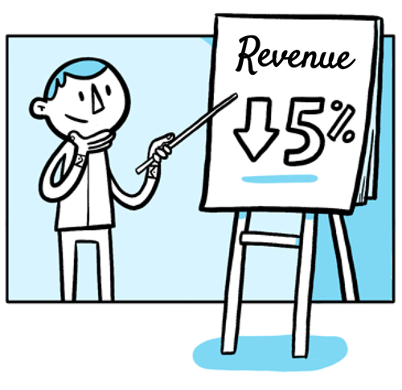
WE CARE BECAUSE CUSTOMER CHURN IMPACTS EVERY BUSINESS:
Lost jobs
Lost Profit
Increased Sales and Marketing Expenses
Additional Work Created/Lost Productivity
Increased stress
Notes:
https://towardsdatascience.com/hands-on-predict-customer-churn-5c2a42806266

Slide 3
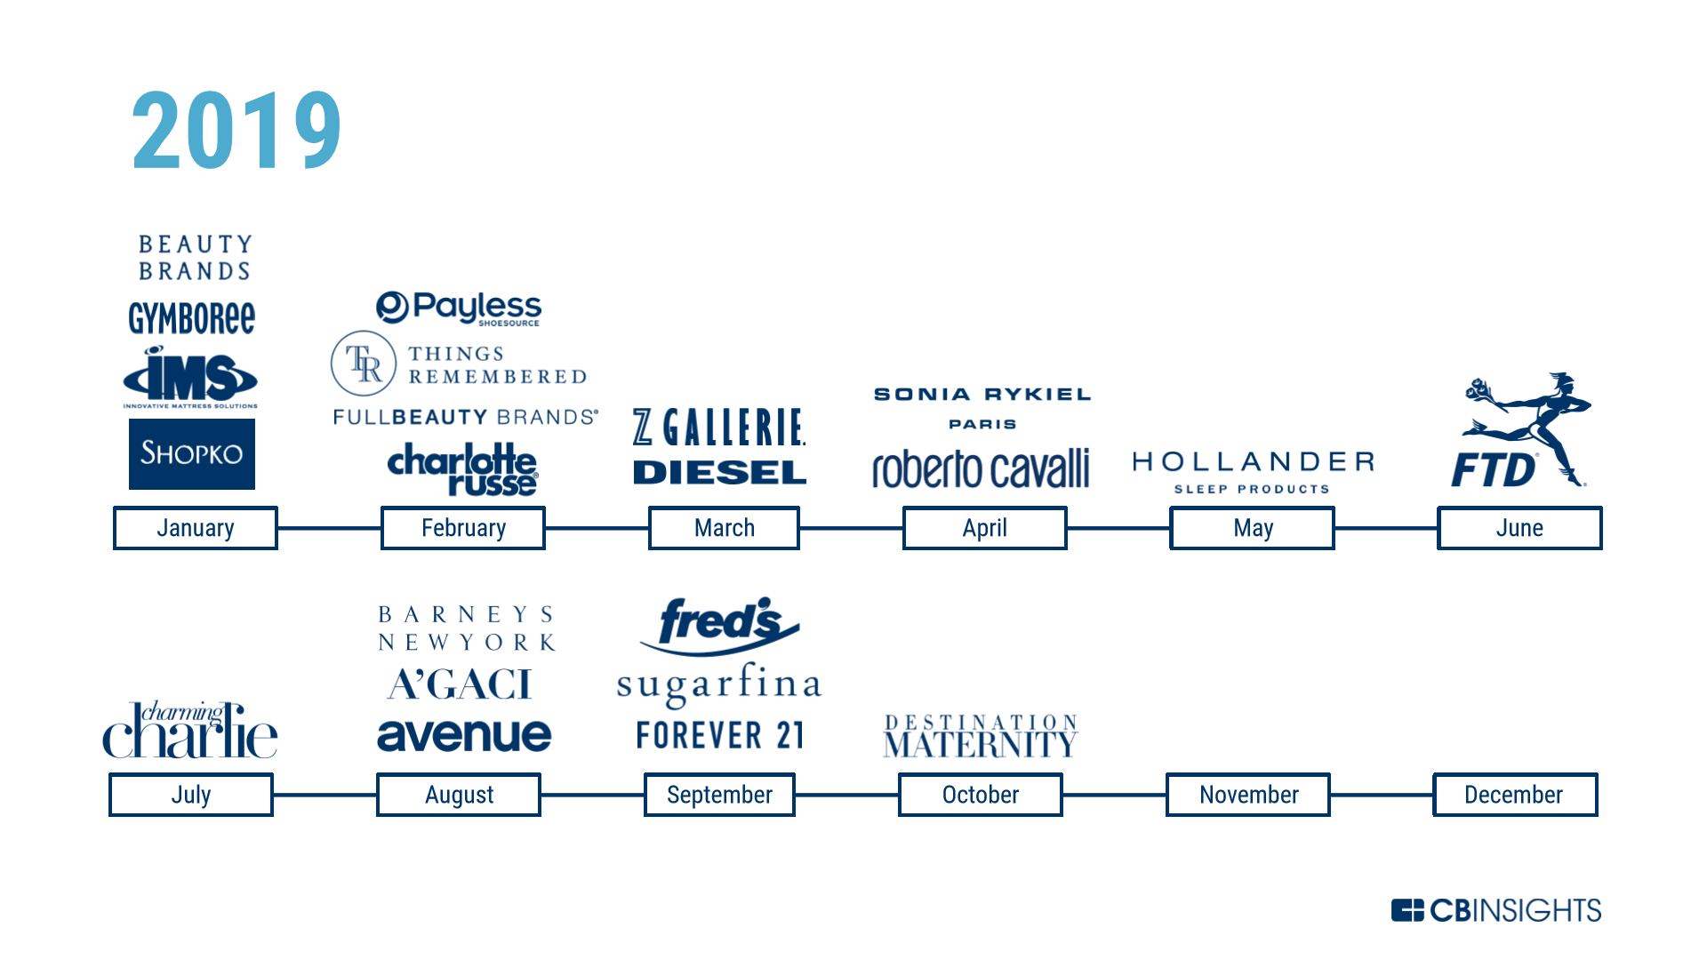
Just a minute sample of “better known” businesses that files Bankrupcy in 2019! We all know more!
Notes:
https://towardsdatascience.com/hands-on-predict-customer-churn-5c2a42806266

Slide 4
WE CARE BECAUSE CUSTOMER CHURN IMPACTS EVERY BUSINESS
According to research firm, CallMiner, avoidable customer churn is costing US businesses $136 billion a year. CallMiner surveyed 1,000 US adults to find out why consumers contact suppliers, how they were feeling when they contacted a call centers and which communications channels they preferred. What we uncovered is a switching epidemic – and that call centers play a pivotal role in whether consumers stay loyal or decide to switch.
Notes:
https://towardsdatascience.com/hands-on-predict-customer-churn-5c2a42806266

Slide 5

Other Frightening Facts that have us running to examine Customer Churn:
U.S. companies lose $136.8 billion per year due to avoidable consumer switching. (CallMiner)
More than half of Americans have scrapped a planned purchase or transaction because of bad service. (American Express)
33% of Americans say they’ll consider switching companies after just a single instance of poor service. (American Express)
Companies with great experiences have a 16% price premium on products and services. (PWC)
63% of U.S. consumers say they’d share more personal information with a company that offers a great experience. (PWC)
After having a positive experience with a company, 77% of customers would recommend it to a friend. (Temkin Group)
Notes:
https://towardsdatascience.com/hands-on-predict-customer-churn-5c2a42806266

Slide 6
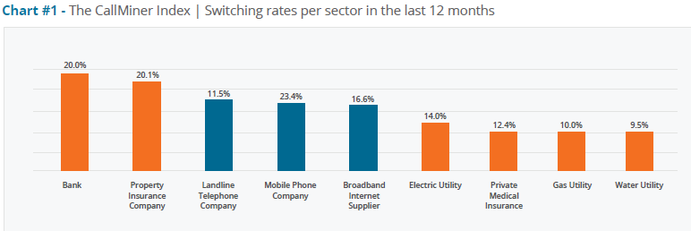
2017 to 2018 Customer Churn by Sector
Notes:
https://towardsdatascience.com/hands-on-predict-customer-churn-5c2a42806266

Slide 7

Let’s Take the RIGHT ACTION!
We attempt to predict churn rate and
Beat the accuracy of other potentially ineffective approaches such as:
Faulty business changes such as advertising that produces little measurable results
Basic marketing and competitive analyst which overlooks deep analysis insights

Slide 8

PROJECT STEPS
Analyze a Customer Churn Data Set to:
Discuss/determine goals and metrics for the project. Is reducing churn the right problem to solve? How specifically shall we measure performance improvement? What is our success goal? (Assume here: it is the right problem, we measure performance overall by reducing customer churn, success is reducing customer churn by 10% in next 6 months).
Understand what deliverables are useful for internal stakeholders (Assume it is churn prediction factors, later a spreadsheet of customer churn predictions, production pipeline and perhaps an internal dashboard).

Slide 9
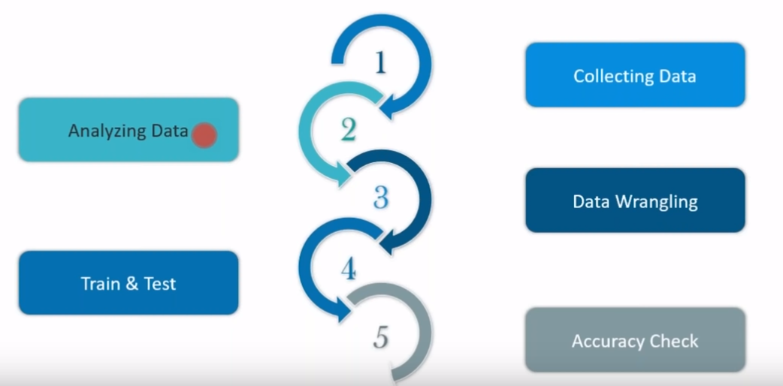
The 5 step Process to Analyze World Bank Data Set
Connecting to meaningful
accurate data sources
Exploring the data and visualization
Data preprocessing
Splitting Data
Resampling Training Data
Classifiers and Evaluation
Tunning the parameters

Slide 10
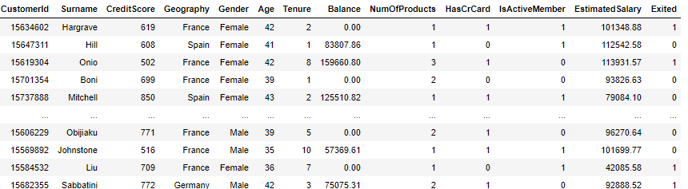
Process 1: Collecting Data
The World Bank Data have provided me with an 11 year .csv file for me to work with.
The Data set below has 13 variables to from which to develop a predictive churn model from.

Slide 11

Process 2: - Analyzing & Exploring the Data

Slide 12
Process 2: - Analyzing & Exploring the Data
I notice the data is incomplete and leaves a lot of unanswered questions.
Would it be possible to obtain balances over a period of time as opposed to a single date?
What date did the customer exit?
What types of products are the customers in?
Could they have exited from a product and not the bank?
For this exercise, we proceed to model without context even though typically having context and better understanding of the data extraction process would give better insight and possibly lead to better and contextual results of the modelling process

Slide 13
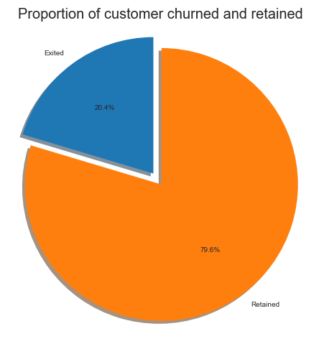
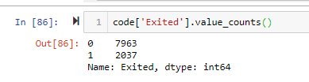
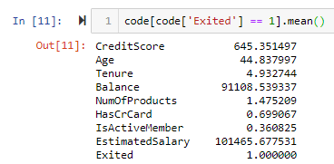
Process 2: - Analyzing & Exploring the Data
To begin I need to verify the type of data, what % is useable and look for patterns; I notice that of the 10,000 customers of Word Bank, 2,037 have churned in the past 11 years which is a 20% Churn Rate; which is considered an average to high rate among industry experts. I also review the averages in the variables where customers have churned.

Slide 14
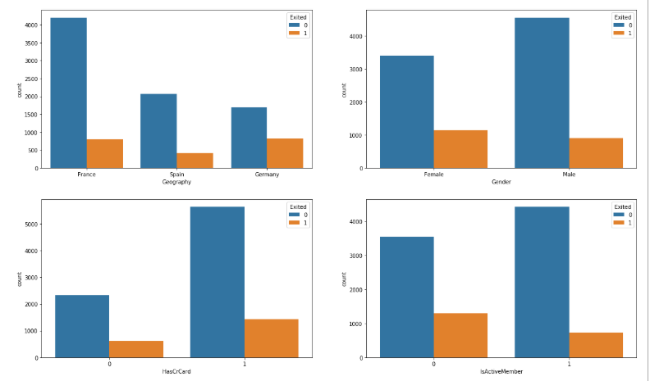
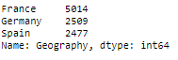
Process 2: - Exploring the “Categorical Data” Variables
Compare the Churn rates by Gender, Geography, Credit Card Holder, and Product Participation:
Notes:
In order to get a larger understanding of the types of customers that Churn I

Slide 15
Findings From Categorical Variables
We discovered the following:
The country of France has the least churn rate and Germany the highest. However, the proportion of churned customers is with inversely related to the population of customers alluding to the bank possibly having a problem (maybe not enough customer service resources allocated) in the areas where it has fewer clients.
The proportion of female customers churning is also greater than that of male customers
Oddly, the majority of the customers that churned are those with credit cards. The majority of customers have credit cards so this could just be a coincidence.
The inactive members have a greater churn. The overall proportion of inactive members is quite high suggesting that the bank may need a program implemented to turn this group to active customers as this can have a positive impact on the customer churn.

Slide 16
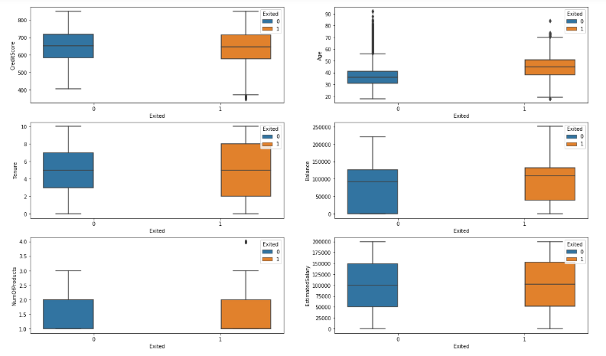
Now the “Continuous Variables” are compared against Churn

Slide 17
Findings for “Continuous Data” Variables
Interestingly, either the product nor the salary has an impactful effect on the likelihood to churn.
There is no significant difference in the credit score distribution between retained and churned customers.
With regard to the tenure, the average tenured client which is 5 years had a lesser likelihood to churn where those customers on opposing spectrums (spent little time with the bank to a lot of time with the bank) were more likely to churn.
Worryingly, the bank is losing customers with significant bank balances which is likely to hit their available capital for lending. The average bank balance for a churned customer is $91,000 with an average bank balance of $101,465.
One interesting find is the older customers are churning at more than the younger ones which alludes to the fact that the bank may not adequate service standards that meet customer service expectations of older clients. Another conclusion is that they may be retiring and consolidating their assets elsewhere. The bank may gain from creating additional services plans for this client base.

Slide 18
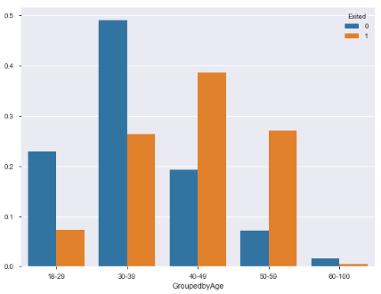
Age Grouping and Trend Investigation
We notice the highest churn group is between 40 and 59
Customer Churn by %

Slide 19
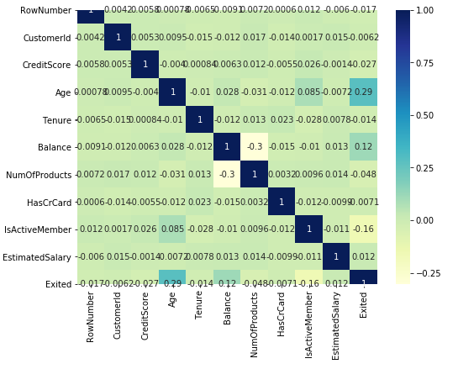
DOES THIS CONNECT? Let’s look our relationships using correlation
In this Heatmap, I used Pearson's correlation coefficient which is the test statistics that measures the statistical relationship, or association, between two continuous variables. It is known as the best method of measuring the association between variables of interest because it is based on the method of covariance.
The strongest correlation I noticed was the Age variant (.29) which corresponds to my Age box Plot.

Slide 20
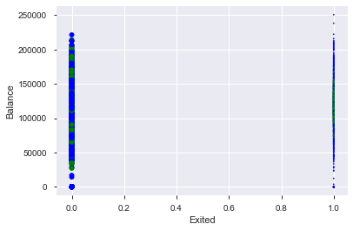
Germany had the highest Churn Rate and France the lowest with both having similar bank balances profile though France had slightly higher balances

Slide 21
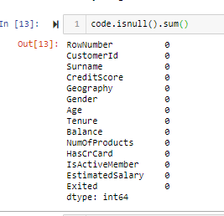
Step 3 – Data Wrangling
My Dataset had no “Null” values
so no need to fill or add mean data
From my Data Set I dropped
Columns that had
zero impact on my results:

Slide 22
Step 3 – Data Wrangling
I introduce 3 new variables by combining 3 existing variables as they had correlations to each other and would improve my analysis.
I created 3 new variables that correlated to each other to better: Balance/Salary, TenurebyAge, and CreditScore Given Age

Slide 23
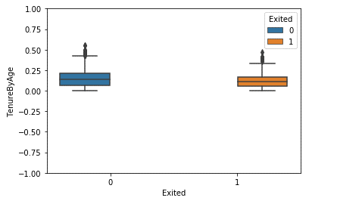
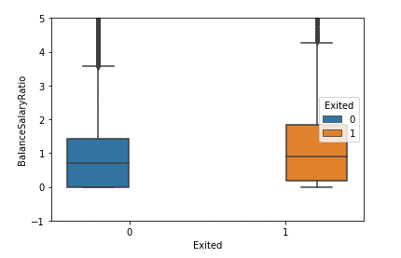
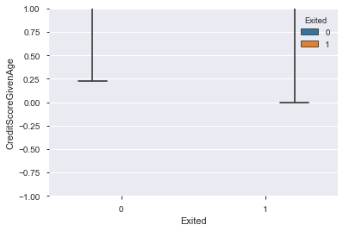
Results of 3 New Combined Variables
We see visit evidence of a slightly higher Churn rate among those with a higher Balance/Salary Ratio

Slide 24
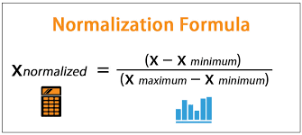
Step Step 3 – Data Wrangling - Normalization3 – Data Wrangling
I use the min/max operations to scale my “continuous variables” to eliminate unnecessary variances. Min/Max is also known as “Normalization”. This formula behind this is below: These “normalization” techniques help in comparing corresponding normalized values from two or more different data sets in a way that it eliminates the effects of the variation in the scale of the data sets i.e. a data set with large values can be easily compared with a data set of smaller values.

Slide 25

Step 3 – Data Wrangling3
Hot Key encoding: In the dataset, there are some variables with numerical values, some variables with categories and some variables with binary values (0 and 1). For numerical and binary variables, we do not worry about labeling. However, we perform label encoding for the categorical variables. This step is carried out on the whole dataset. I “Hot Key” encoded the following variables: Gender and Geography to transform them to binary using a “for”/”if” statement. I performed “Hot Label Encoding” where I changed the value “0” (no churn) in the two categorical variables “Has Credit Card” and “Is Active Member” to a -1 to show a negative relationship more clearly.

Slide 26

Step 3 – Data Wrangling3 rangling – Data Splitting into Test/Train
Data splitting: This involves splitting the label encoded dataset into train and test datasets. In this project I separated the data to a 70/30 ratio. The fractions of both classes remain the same in train (70) and test (30) datasets. This is to avoid what is known as “overfitting” of data which related to applying my newly created Churn Model to general unused data (test data) after I train my models on my “train” data set.

Slide 27
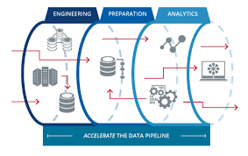
Step 4 – Train and Test the Data
Modeling Pipeline
Next, I build a “Data Pipeline” In Python which allows the me to transform data from one representation to another through a series of steps. In other words, to ensure my hot encoding, min/max normalization and both my categorical and continuous variables continue in the test and train modeling

Slide 28
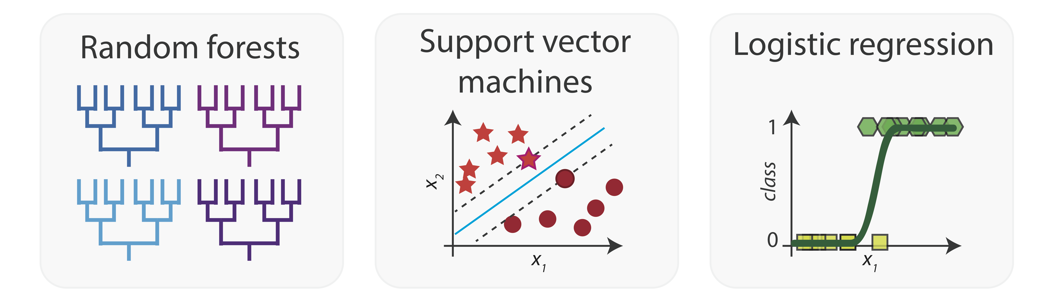
Step 4 – Train and Test the Data – Feeding the Data into an Algorithm

Slide 29
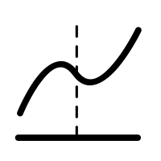
Step 4 – Train and Test the Data – Logistic Regression – Model 1
Logistic Regression: Logistic Regression is one of the basic and popular algorithm to solve a classification problem. It is named as ‘Logistic Regression’, because it’s underlying technique is quite the same as Linear Regression. The term “Logistic” is taken from the Logit function that is used in this method of classification which uses the Sigmoid function.

Slide 30
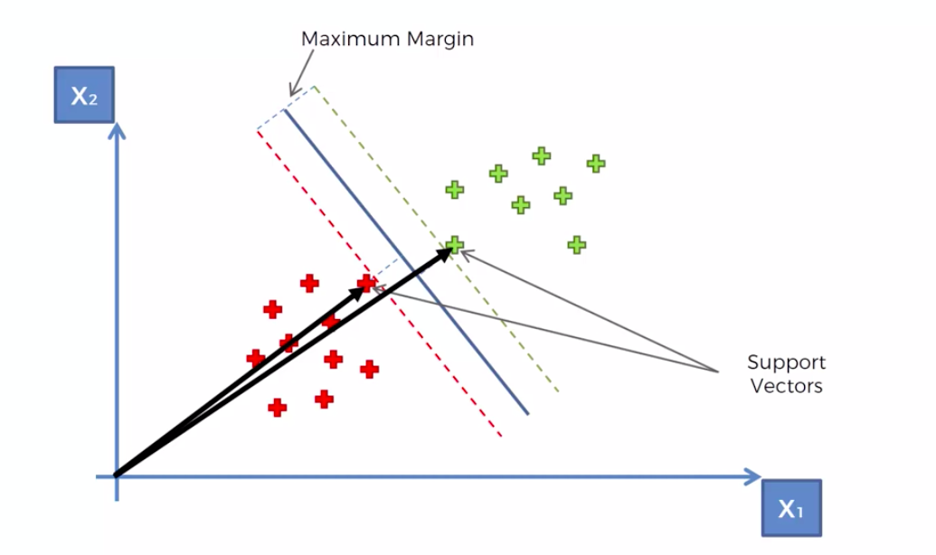
Step 4 – Train and Test the Data – SVM Model 2
Support Vector Machine (SVM) is a supervised machine learning algorithm which can be used for both classification and regression challenges. SVM is mostly used in classification problems. In this algorithm, we plot each data item as a point in n-dimensional space (where n is number of features you have) with the value of each feature being the value of a coordinate. SVM is better suited as I need a way to separate my data into CHURN or NO CHURN and Logistic Regression uses a straight line. SVM also maximizes margin, so the model is slightly more robust, but more importantly: SVM supports kernels, so you can model even non-linear relations. Given a set of training examples, each marked for belonging to one of two categories, an SVM training algorithm builds a model that assigns new examples into one category or the other, making it a non-probabilistic binary linear classifier which my data requires to build the Churn/No Churn model as mentioned earlier.
Source: Wikipedia

Slide 31
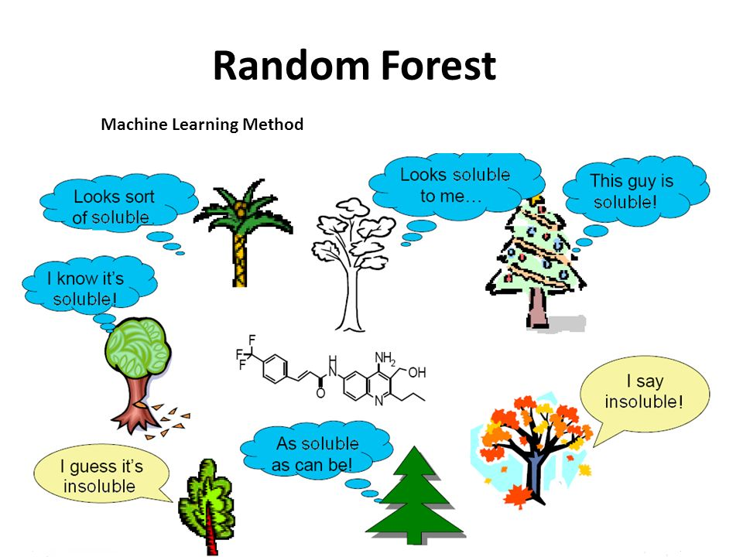
Step 4 – Train and Test the Data – Random Forest – Model 3
Random Forest works well with a mixture of numerical and categorical features which the Bank Churn data has. When features are on the various scales, it is also fine. Roughly speaking, with Random Forest you can use the data as it is. Random Forest uses a large # of trees, works with missing values and is often considered to be a highly accurate model for both regression and classification problems.
Source: Wikipedia

Slide 32
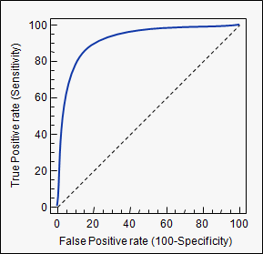
Step 5 – Accuracy Check – Did the 3 models make it?
A ROC curve plots TPR vs. FPR at different classification thresholds. Lowering the classification threshold classifies more items as positive, thus increasing both False Positives and True Positives.
AUC - ROC curve is a performance measurement for classification problem at various thresholds settings. ROC is a probability curve and the AUC represents degree or measure of separability. It tells how much model is capable of distinguishing between classes. The Higher the AUC, better the model is at predicting 0s as 0s and 1s as 1s. By analogy, Higher the AUC, better the model is at distinguishing between patients with disease and no disease.
The ROC curve is plotted with TPR against the FPR where TPR is on y-axis and FPR is on the x-axis.
Source: Toward Data Science

Slide 33
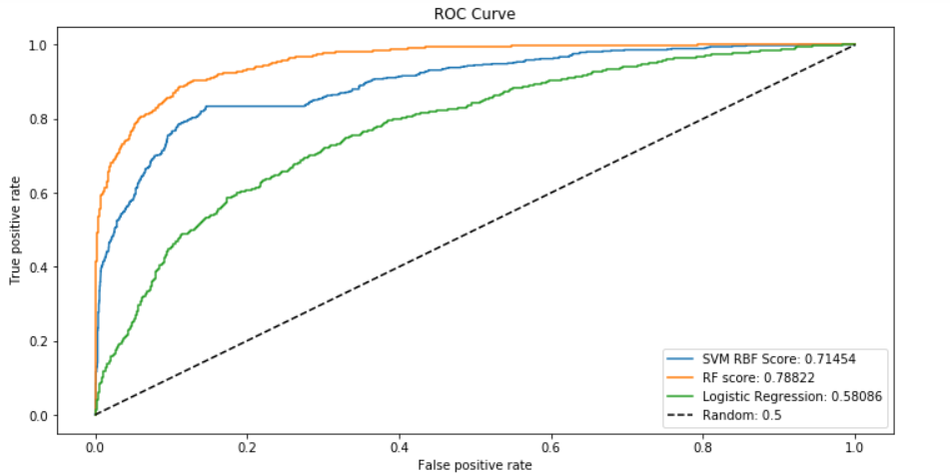
Step 5 – Accuracy Check – Bank Churn Results
We see that the Random Forest Algorithm had the best results with 78% which means it is able to correctly classify the client data into a “churn” or “no churn” category 78% of the time.

Slide 34

Final Thoughts and Conclusions
Though my examination of the small data set I did discover a few significant findings:
There is no significant difference in the credit score distribution between retained and churned customers.
The older customers (over 35) are churning at a higher rate than the younger ones alluding to a difference in service preference in the age categories. The bank may need to review their target market or review the strategy for retention between the different age groups
Bank members with an average tenure are slightly less likely to churn than those with either low or high number of tenure years.

Slide 35
Final Thoughts and Conclusions
Continued….
The data shows that customers with higher balances are churning at a higher rate which is cause for concern for their lending capability. The bank could benefit from offering special programs when, say, a balance of $75,000 and offer a higher rate of interest on a savings account or special investment privileges.
Neither the product nor the salary has a significant effect on the likelihood to churn.
More females have churned than males
More credit card holders churn though most of the bank customers possess credit cards. The bank can benefit from increasing incentives in keeping credit card holders.

Slide 36
Final Thoughts and Conclusions
The study can be greatly improved with the following data since there are many unanswered questions:
Would it be possible to obtain balances over time as opposed to a single date?
What date did the customer exit?
What types of products are the customers in?
Could they have exited from a product and not the bank?
Does the bank have an investment division?
Did the customer actually retire and consolidate assets elsewhere?
Are there NPS scores to factor into the data?
Of course, every business needs to perform analysis and take measures to prevent Customer Churn; considering the cost of acquiring each customer, a study should be an annual requirement.

Slide 37

Carolyn Massa
Technical Trainer/Project Manager
tech exec, entrepreneur
Masters in Information Technology
Personal site: revinformatics.com
GitHub: TBA
Email: carolyn@revinformatics.com
Twitter:
LinkedIn: https://www.linkedin.com/in/carolynmassa

